Slide 1





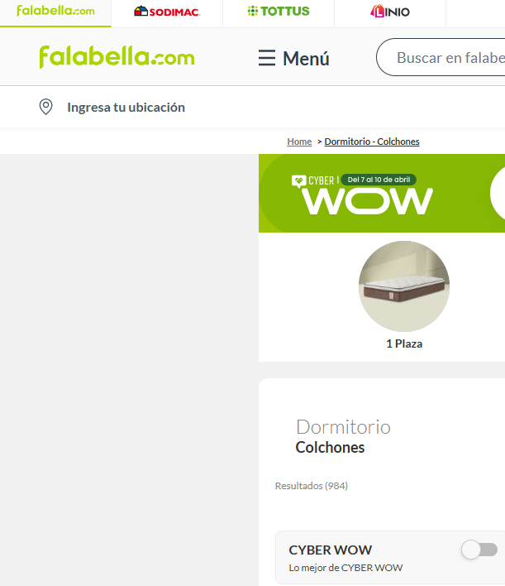
#C2D017
#A9D500
#019036
#C067FB
#4D2B8D
#036826
#C6D953
#F1F1F1

